Slide 1
Welcome! MPages Overview MedStar
Brian Heits
Associate Lead Software Engineer
July 8, 2019

Slide 2
Agenda
Overview
MPages – Things to know
Technical Topics
MPage Web Service
Agenda

Slide 3
Overview

Slide 4
Overview
MPages (formerly known as Discern Desktop) – Solution at a Glance:
MPages allows you to create
unique views of real-time clinical data
within your integrated electronic medical
record (EMR).

Slide 5
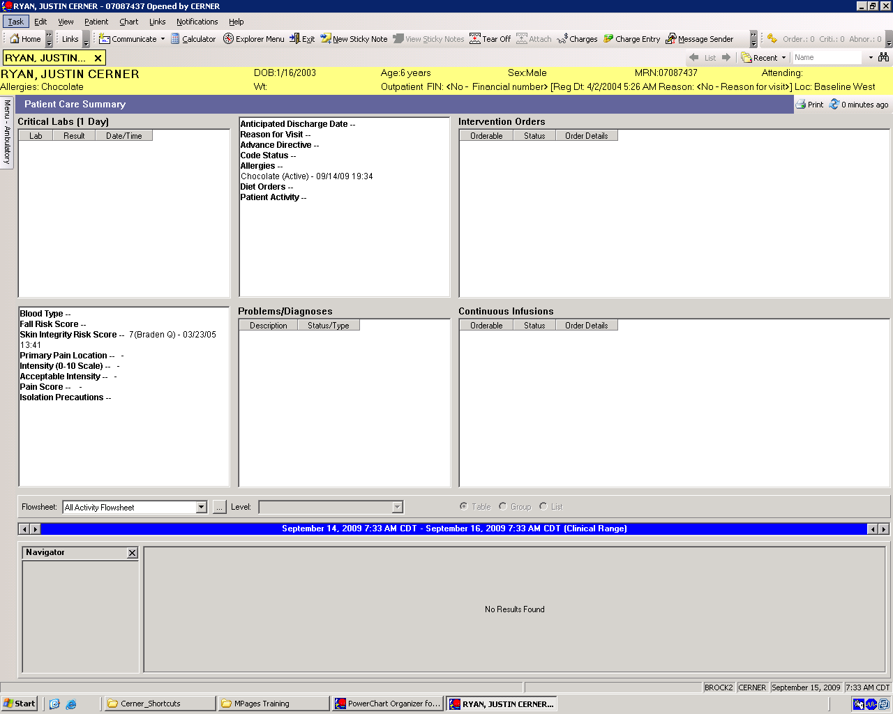
Overview – Genview versus MPages
Sounds like a Genview, but what’s the difference?

Slide 6
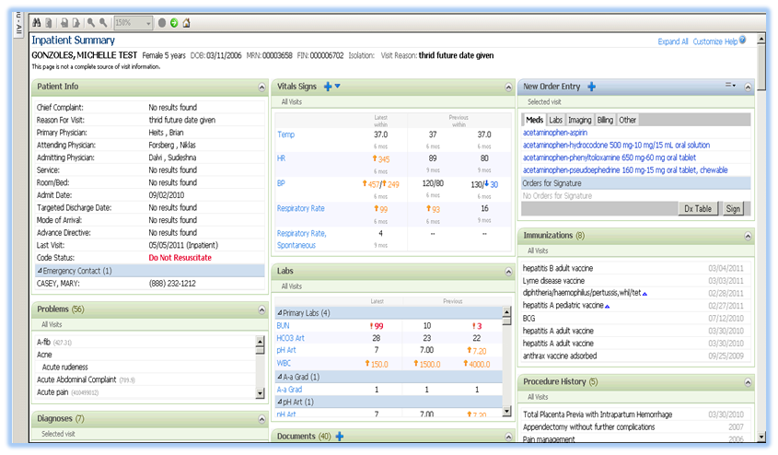
Overview – Mpage Solutions
Web-based Platform
Operates within the framework of PowerChart®, FirstNet®, SurgiNet®, INet®®,
Can run as a web service
Client Configurable
CCL extracts the data
Web technologies (HTML, Javascript,
CSS) create the user interface
Data Aggregator
Reduce clicks
Patient-specific and population-
based views
Interactive / Actionable
Navigation to various chart
components
Open core applications from page
Real-Time
Data refreshed when page is opened

Slide 7
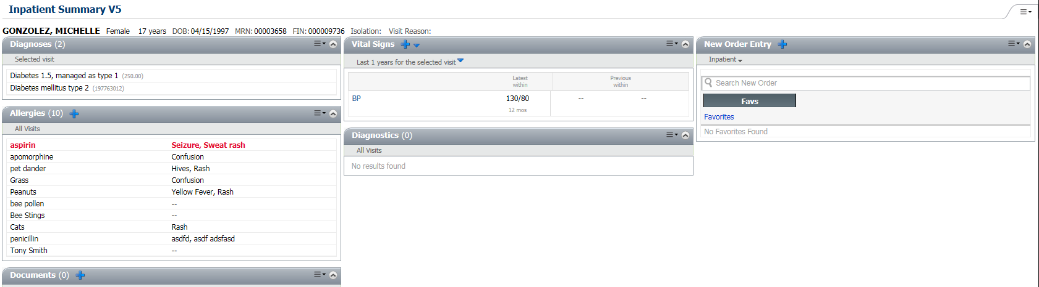
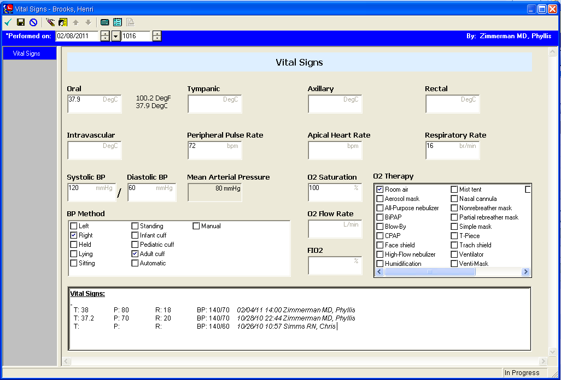
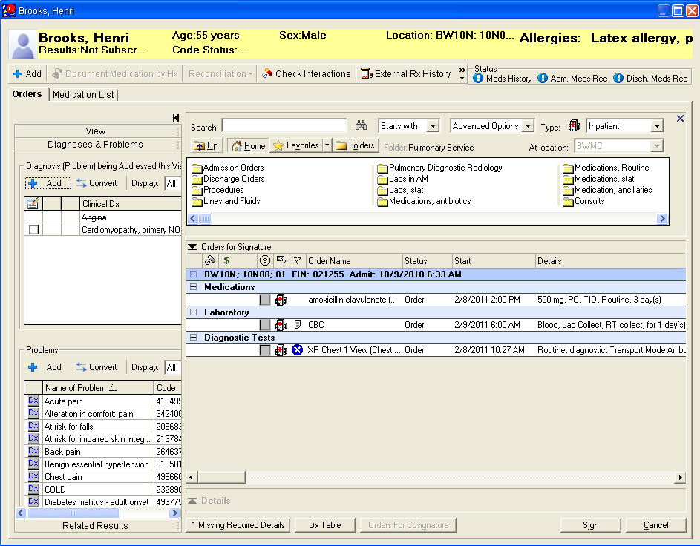
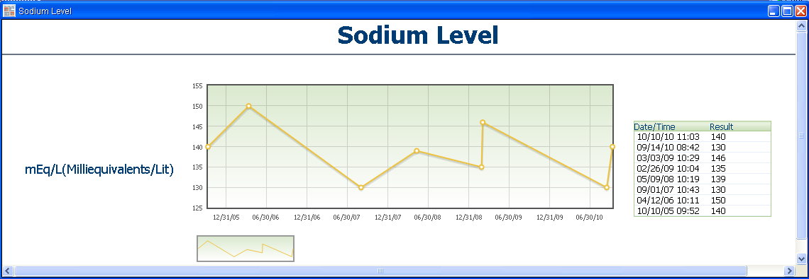
Overview – Interactive Solution
Document
Order
Graphing

Slide 8
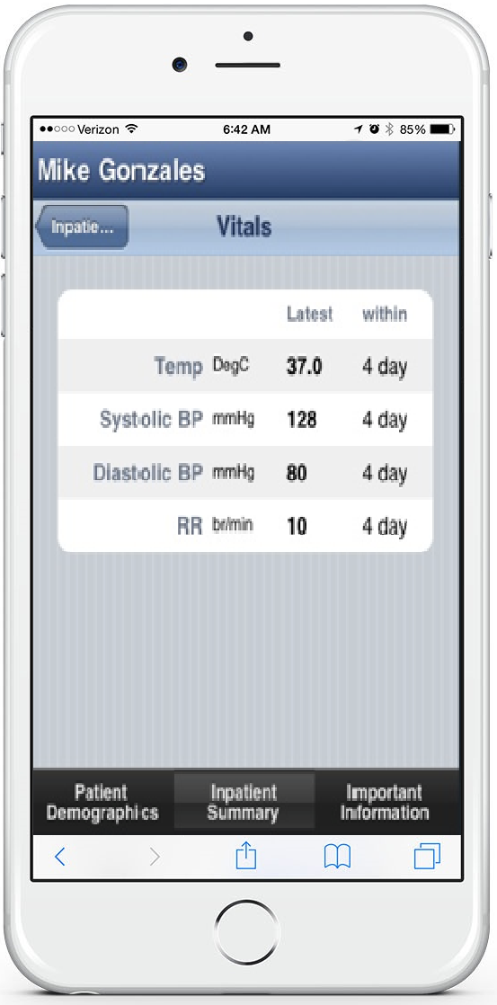
Overview – MPages Mobile
Web Service
Provides the ability to open pages on any web browser:
Internet Explorer,
iPhone
Mobile device, etc.
Ability to launch MPages as an iAware Gadget

Slide 9
Overview – History at a Glance
2008
2009-2010
2011-2014
MPages 1.0
MPages 2.0
MPages 2.5, 4.x
Custom MPage Tab
Link to top level tabs
in Patient Chart
Integrate 3rd Party
Data
External Web Apps
Web Service
Application Launch
PowerForms, New Orders, Allergy control, PowerNote
AJAX
Reusable Components
Core Services
Physician Viewpoints
Custom Components
2014-current
MPages 5.x/6.x
Faster load times through Bedrock caching and dynamic static content (EJB)

Slide 10
MPages – Things to know

Slide 11
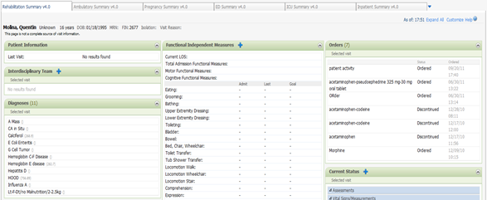
MPages – Common Question
What is the difference between a View and a Viewpoint?
View ➔ an MPage created within the standard framework
Standard Framework ➔ MPages released through Content packages and set-up using Bedrock
Viewpoint ➔ a collection of Views

Slide 12
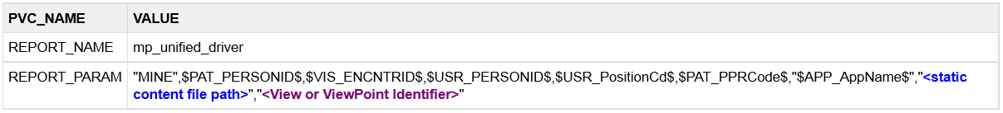


MPages – Prefmaint setup
Example:
"MINE", $PAT_PERSONID$, $VIS_ENCNTRID$, $USR_PERSONID$, $USR_PositionCd$, $PAT_PPRCode$, "$APP_AppName$", "", "VB_AMBULATORYSUMMARYVIEW “
Note: In the example above, there is no static content folder or file path. Also, there is no IBM WebSphere file path in the REPORT_PARAM string, because MPages 5.0 caches the static content on the WebSphere server.

Slide 13
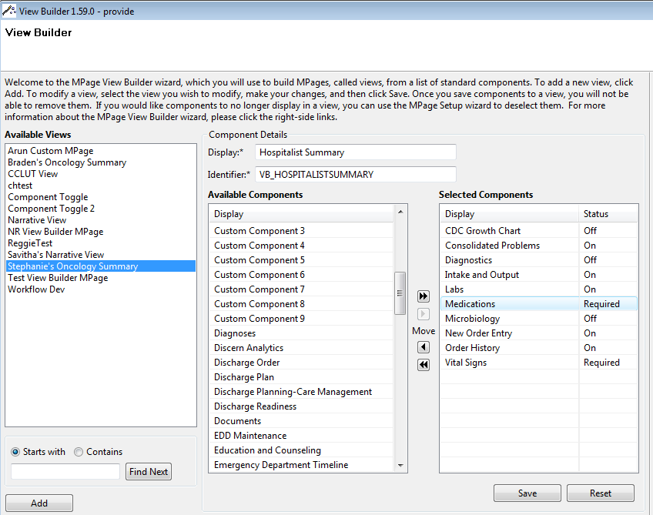
MPages – Views
Can be standalone (not within a viewpoint)
Facility defined view name
Select content from component library
Define “status”
Required
Off (By Default)
On (By Default)
Identifier is used as last parameter when calling driver script (will make it standalone)

Slide 14
MPages – Viewpoints
Single point of access from TOC
Sort view via drag and drop
Created by adding already created views within Bedrock

Slide 15
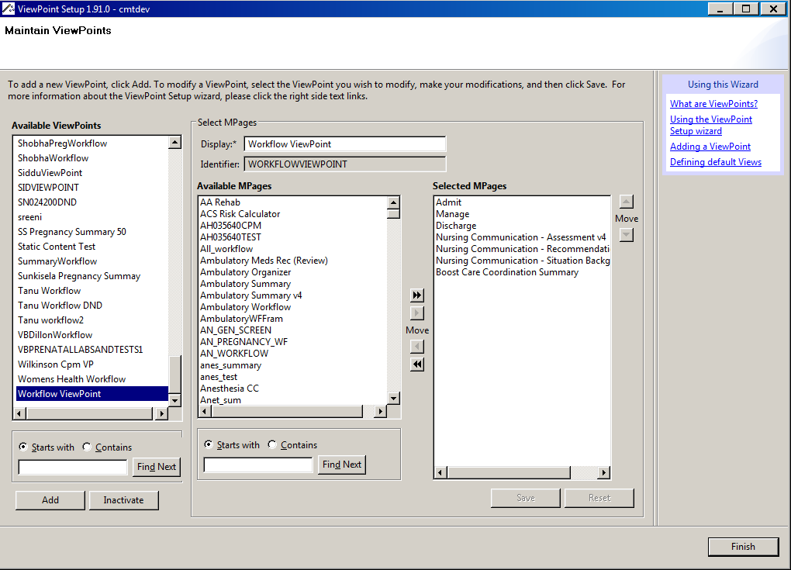
MPages – Viewpoints
Select previously created views to be added to a single viewpoint
Identifier is used as last parameter when calling driver script

Slide 16
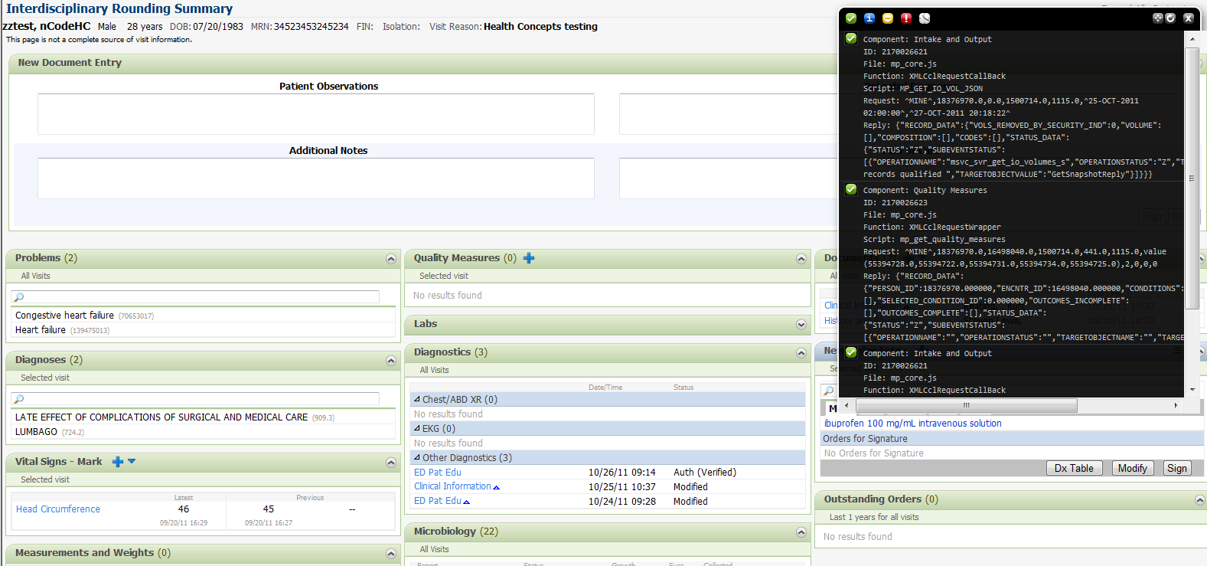
MPages - Blackbird
Provides front-end logging capabilities
Activated by pressing Ctrl+\ and then refreshing Mpage
All scripts call information logged
Only accessible within standard MPages

Slide 17
MPages – Bedrock Caching
Why is the EJS Important and What Does it do?
Bedrock Settings for Views and ViewPoints are cached using the EJS.
Process improves performance by rarely querying the Bedrock tables when a refresh or load occurs.
In the future, the EJS will be used for additional functionality other than caching Bedrock settings.
What if I need to make Bedrock changes?
If a change needs to be made and it’s minor, change the settings and then cycle server 535.
If installing a package with a lot of setup, the EJS provides a “No Cache” property. Just make sure it is turned off when done.
Can the EJS fail, and what’s the Fail-Over Plan?
If it fails, the system automatically reads from the Bedrock tables on every load and refresh. This is will cause a decrease in performance, but will behave similar to 4.x Mpages.

Slide 18
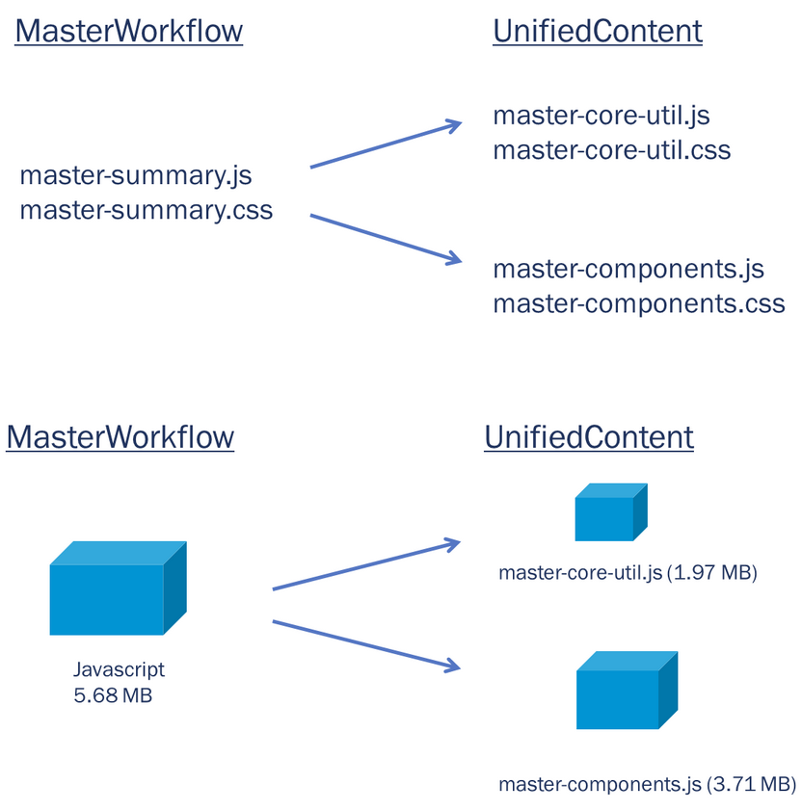
MPages – Web Server
MPages 5.0 release requires a web server due to the static content being hosted on the web server to ensure optimal system performance.
Core utilities have been divided from the component utilities.

Slide 19
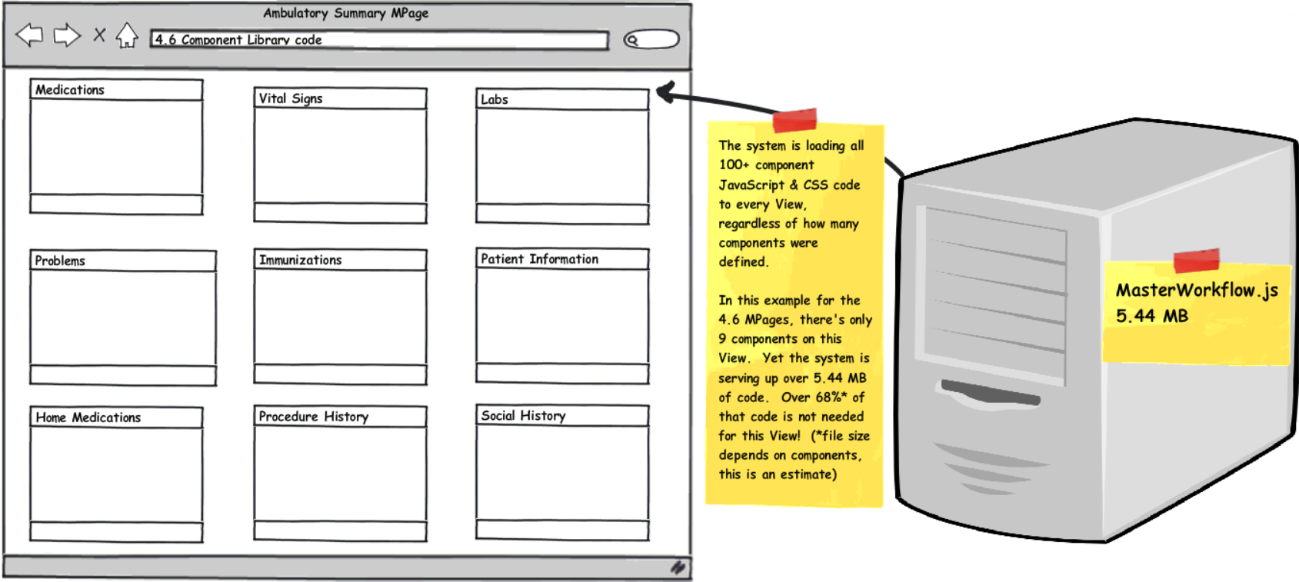
MPages – Dynamic Static Content
Mpages 4.6 release serves up 5.44 Mb of code where 68% of that code is not needed for the view (on average) .

Slide 20
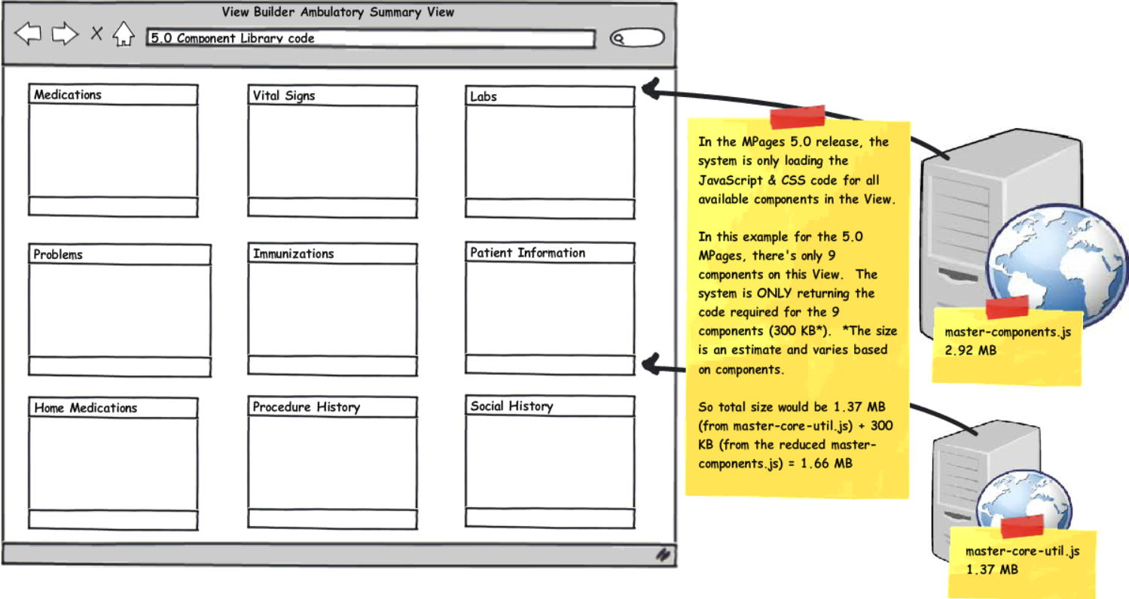
MPages – Dynamic Static Content
MPages 5.0 release only serves up the code for the components that are defined in the Bedrock Define Layout option for this view.
ViewPoints serve up code for all components on all views needed.

Slide 21
MPages – Dynamic Static Content
Do I have to Manually Move my Static Content to the Web Server?
No. In short, the web server, when up and running, grabs the static content from the code warehouse and hosts its on the web server for you.
How does my static content get updated with future releases?
With every package install, there is a period of time where the web server must cycle and refresh to obtain the latest static content (take upwards of 6 minutes).
Any modifications to the static content will require a refresh of your web server.
What happens if my web server fails or goes down?
You can point your views and ViewPoints to the code warehouse using the 8th report param prompt. This will cause a decrease in performance however.
Why do I have to leave my static content file path blank for the report params?
When using the new unified driver, the system expects your static content to be on the web server, and it knows how to fetch it from there.
Do my custom component files need to be back-up before each MPage installation?
It needs to be backed up before installation of MPages 5.0, but after that, no it does not.

Slide 22
MPages - Worklist Columns
Population/Organizer level framework.
Available for PowerChart, FirstNet & SurgiNet.
Must define the worklist for the application at the position level in Preference Maintenance tool.
Custom Column development supported for Patient Organizer View layout type starting from Mpages 6.3.

Slide 23
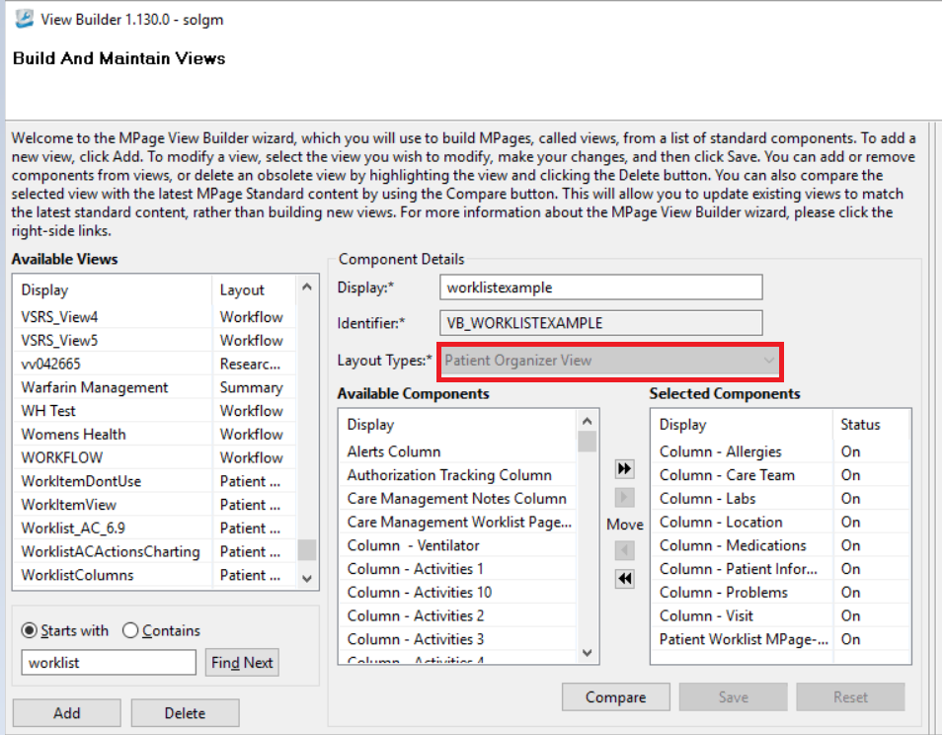
MPages - Worklist Columns
Bedrock - Patient Organizer View

Slide 24
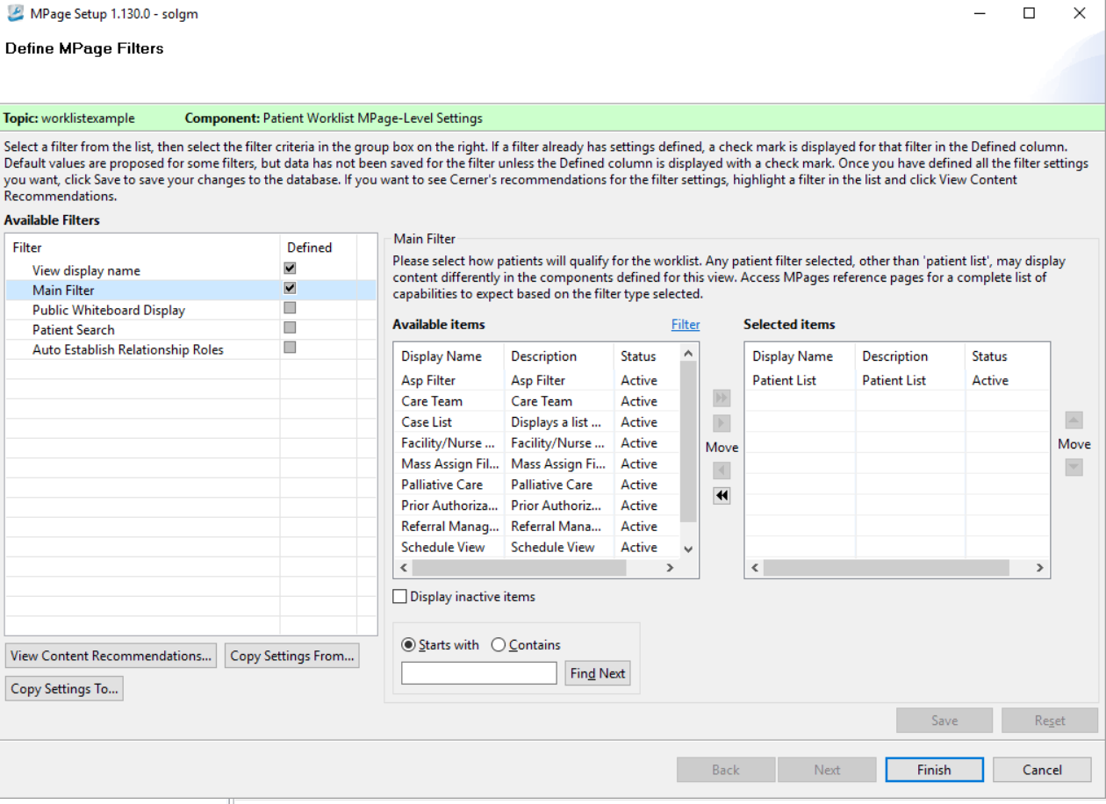
MPages - Worklist Columns
Bedrock - Patient Organizer View

Slide 25
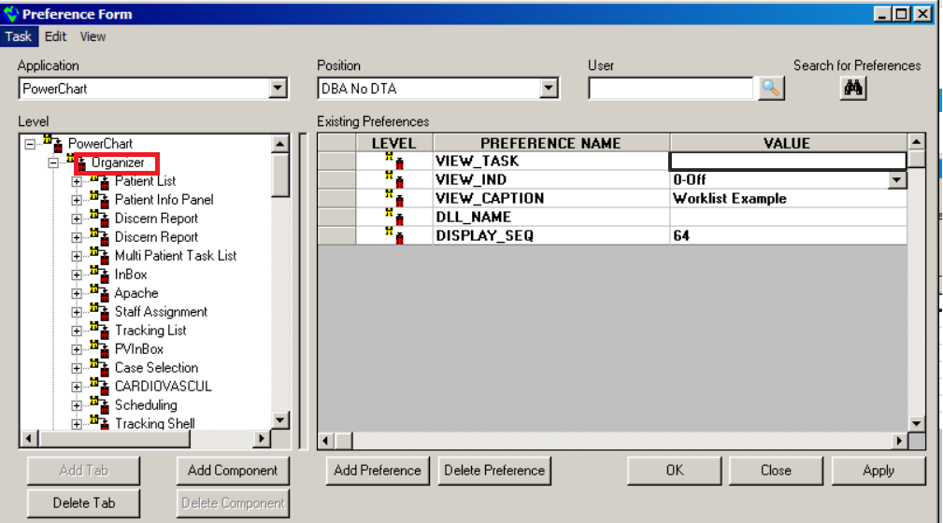
MPages - Worklist Columns
Prefmaint - Add tab Discern Report at Organizer level

Slide 26
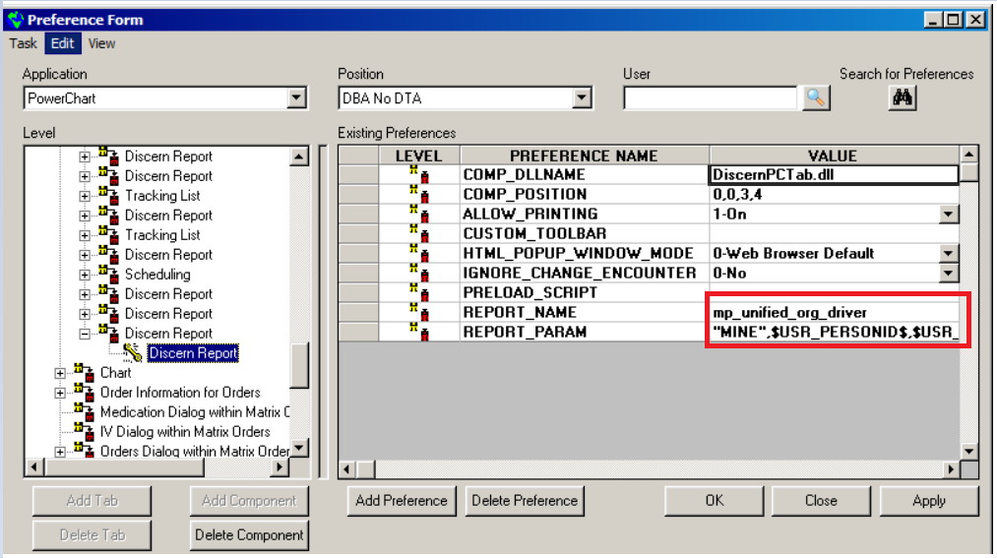
MPages - Worklist Columns
REPORT_NAME: MP_UNIFIED_ORG_DRIVER
REPORT_PARAM: "MINE",$USR_PERSONID$,$USR_PositionCd$,"$APP_AppName$","","[View or ViewPoint Identifier]"

Slide 27
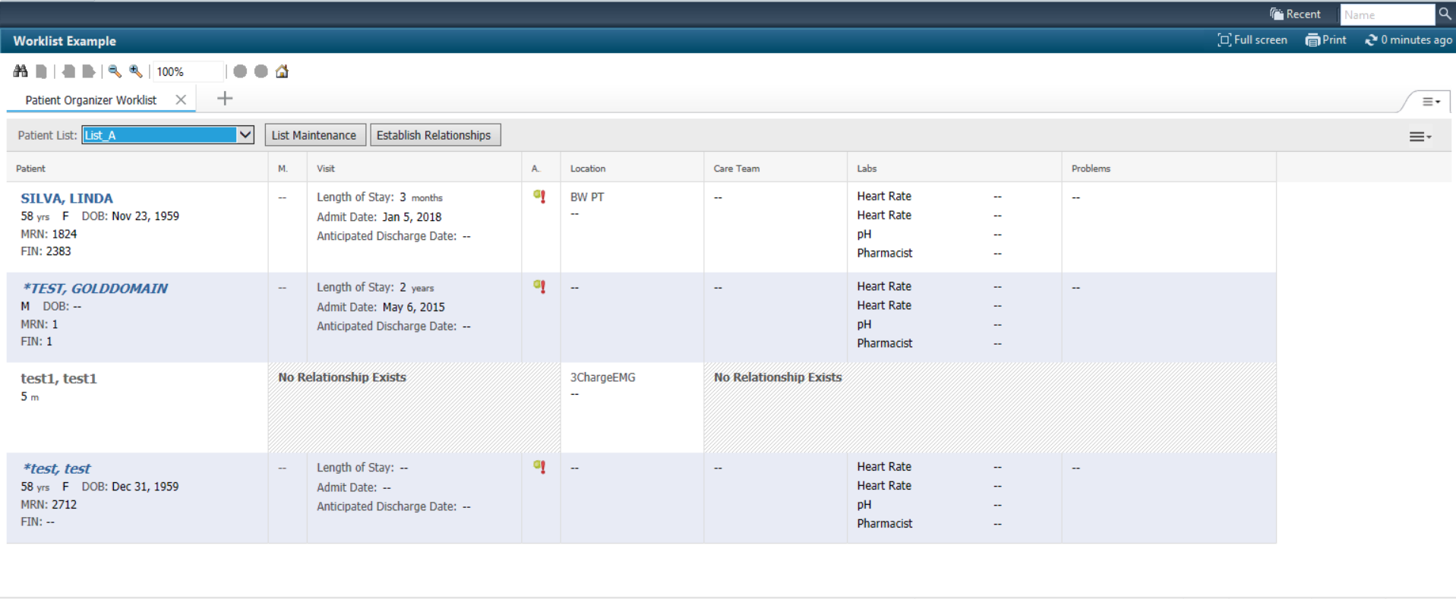
MPages - Worklist Columns
User can choose from available patient lists via the drop down available
All patients present in the patient list will be displayed in the MPage view. A patient with no relationship between the user will also be shown in the list.
Some columns will not show data unless a relationship is established with the patient.
Can configure bedrock settings for some columns like patient information to link to patient level tab.

Slide 28
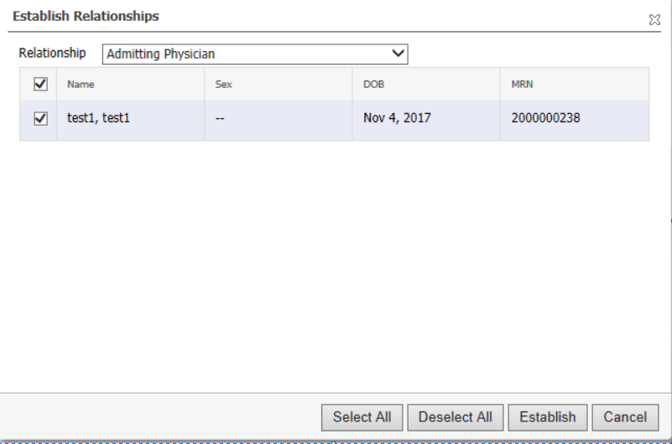
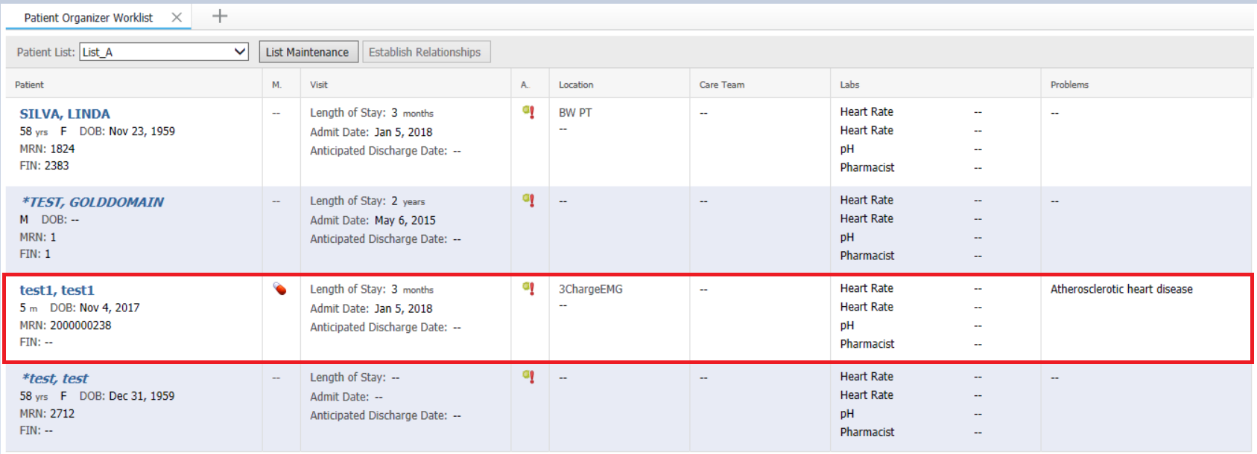
MPages - Worklist Columns
Allows user to establish a relation via the MPage view.
Click on the Establish Relationship button available in the MPage.
A pop up window will appear on the screen allowing the user to establish a relationship
Once the relationship is established all the columns will display data.

Slide 29
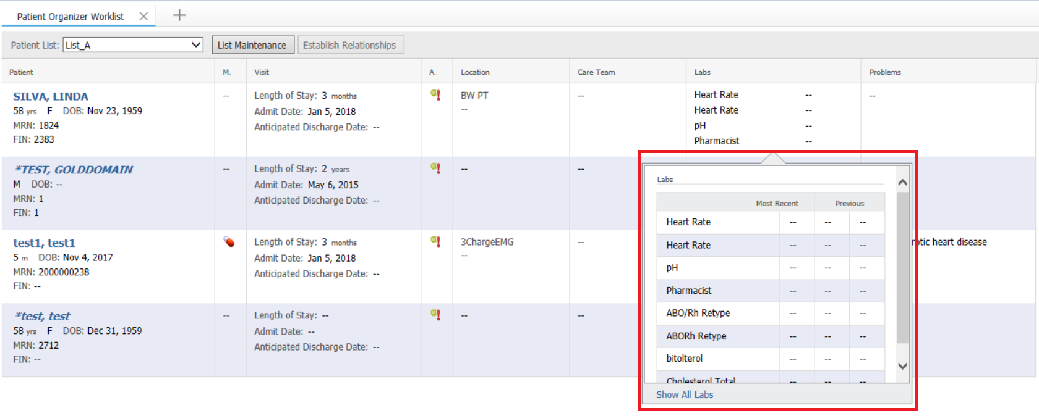
MPages - Worklist Columns
Additional data will be displayed in a pop-up box when a user clicks on a column cell.

Slide 30
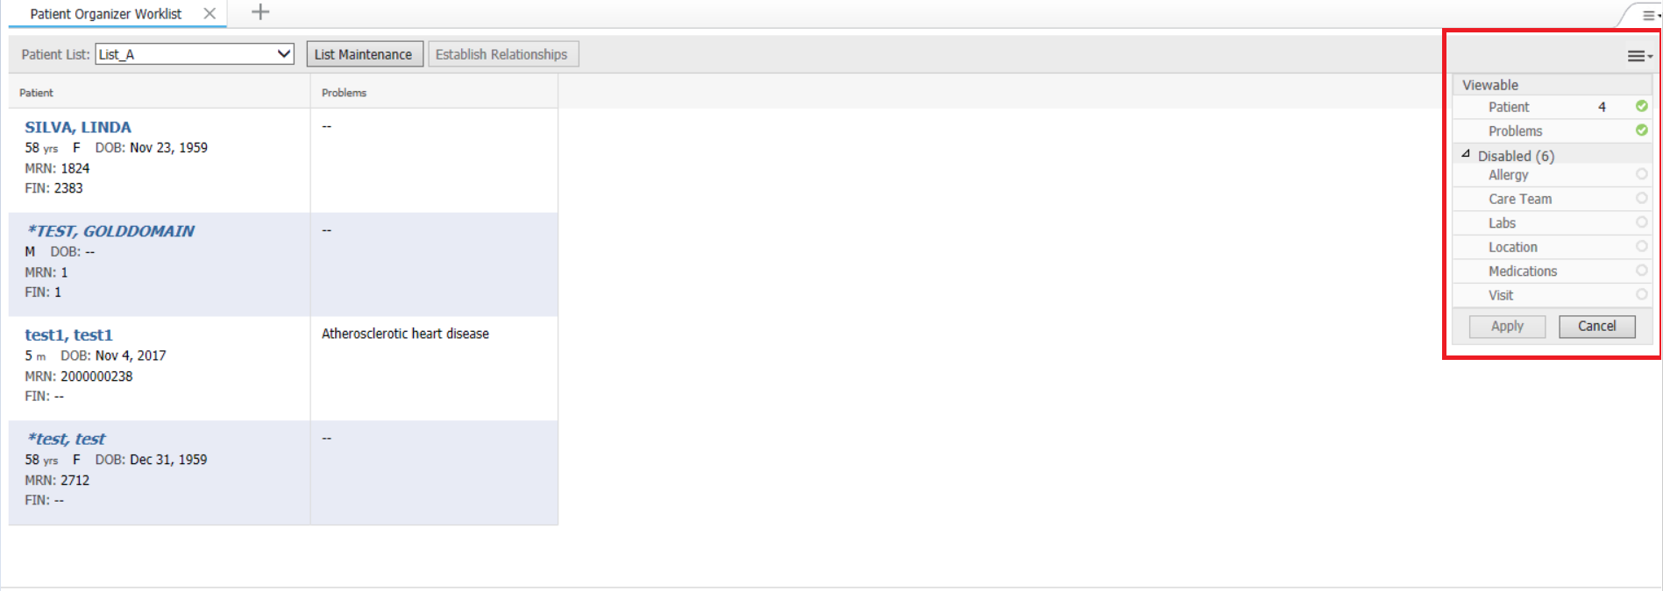
MPages - Worklist Columns
User can choose to enable or disable columns via the worklist MPage view.

Slide 31
MPages - Worklist Columns
Patient Organizer View layout type supports custom columns. Up to ten custom columns can be added.
A Custom CCL scripts will have to be developed for each column.
The CCL script controls the individual cell behavior, including which results are displayed.
The results can be displayed as numbers, icons or text.
CCL also controls data displayed in a pop-up box when user clicks a cell.

Slide 32
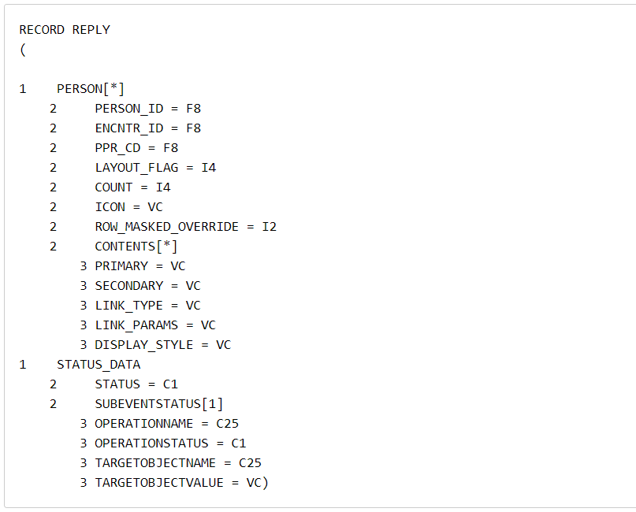
MPages - Custom Worklist Columns
The custom CCL will have a predefined record structure that holds the data displayed.
This is defined by the worklist framework and should not be reinitialized in custom column scripts.
When custom CCL is executed, the person list within the record structure is prepopulated to include all visits the user can view depending on the relationship with the patient.
PERSON_ID, ENCNTR_ID and PPR_CD are also provided in the person list.

Slide 33
MPages – Important Links
MPages Direct Connect – Hub for all MPages questions/links, etc…
https://www.ucern.com/community/cerner/solution_forums/groups/mpages-solution-services
Reference Pages
https://wiki.ucern.com/display/reference/MPages+Reference+Pages
All about MPages 5.0 Release
https://wiki.ucern.com/display/public/reference/All+About+MPages+5.0+Release
Custom Worklist Columns reference page
https://wiki.ucern.com/display/public/reference/Configure+Custom+Columns+for+MPages+Worklists

Slide 34
Technical Topics

Slide 35
Technical Topics - Prefmaint
MPages view = Tab (Powerchart, FirstNet, etc)
Tab uses Web Browser that is local to the server logged into
Use Discern Explorer Help for instructions to create tab in prefmaint

Slide 36
Technical Topics - HTML
HTML is a language for describing web pages
HTML documents describe web pages
MPage = HTML document = Web Page
MPages use HTML document as a ‘shell’ to be populated during run time
MPages use HTML to format output

Slide 37
Technical Topics - HTML
<!DOCTYPE html PUBLIC "-//W3C//DTD XHTML 1.0 Strict//EN" "http://www.w3.org/TR/xhtml1/DTD/xhtml1-strict.dtd">
<?xml version="1.0" encoding="UTF-8" ?>
<html xmlns="http://www.w3.org/1999/xhtml" lang="en" xml:lang="en">
<head>
<meta http-equiv="Content-Type" content="XMLCCLREQUEST,APPLINK,MPAGES_EVENT" name="discern"/>
</head>
<body>
<div class="wrap">
<h1 class="ps-hd"><span>Sample MPage</span></h1>
<div class="section-group" id="sectionOne">
<div id='patientInfoTable'></div>
</div>
</div>
</body>
</html>

Slide 38
Technical Topics – HTML Help
Tutorials
In-house Web developers
Standards
Reusables
Policies and Procedures
Community – uDevelop, uCern
Internet Search
HTML Editor

Slide 39
Technical Topics - Javascript
JavaScript is a scripting language designed to add interactivity to HTML pages
Popups, links, graphs, menus, etc.
JavaScript is embedded into HTML pages
MPages use javascript to retrieve data, format data and add interactivity. JS does much of the work.
Examples

Slide 40
Technical Topics – Javascript Help
Tutorials
In-house Web developers
Standards
Reusables
Policies and Procedures
Community – uDevelop, uCern
Internet Search
HTML Editor

Slide 41
Technical Topics - XML
EXtensible Markup Language
XML was designed to carry data, not to display data
XML tags are not predefined. You must define your own tags
MPages uses XML to carry data from CCL to the javascript
Javascript knows how to handle XML

Slide 42
Technical Topics - XML
/* Begin the xml string */
set sXML->data = "<?xml version='1.0' encoding='iso-8859-1' standalone='no' ?><RPT_DATA>"
select into "nl:"
from
person p
plan p
where p.person_id = $personId
head report
sXML->data = concat(sXML->data, "<patientInfo>")
sXML->data = concat(sXML->data, "<patientInfo_label>Patient Name:</patientInfo_label>")
sXML->data = concat(sXML->data, "<patientInfo_result>", p.name_full_formatted, "</patientInfo_result>")
sXML->data = concat(sXML->data, "</patientInfo>")
with nocounter
/* End the xml string */
set sXML->data = concat(sXML->data, "</RPT_DATA>")

Slide 43
Technical Topics - JSON
JSON (JavaScript Object Notation) is a lightweight data-interchange format.
More compact than using XML, most standard MPages after 2.0 use JSON
Same strict enforcement as XML for structure of JSON records
CCL helper functions to assist with formatting
Example

Slide 44
Technical Topics - JSON
{ "allergies": [
{"allergy": {"allergy_name": "Adhesive bandage", "allergy_reaction": "None Documented"}},
{"allergy": {"allergy_name": "Ambien", "allergy_reaction": "Coma (3)"}},
{"allergy": {"allergy_name": "Tylenol", "allergy_reaction": "None Documented"}},
{"allergy": {"allergy_name": "aspirin", "allergy_reaction": "Nausea"}},
{"allergy": {"allergy_name": "penicillins", "allergy_reaction": "Hives, flourescent green rash"}}
]}

Slide 45
Technical Topics - CSS
Cascading Style Sheet
Styles define how to display HTML elements
CSS is embedded into HTML pages
MPages uses stylesheets to drive the display of output
Example

Slide 46
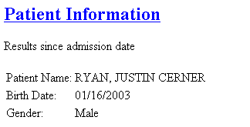
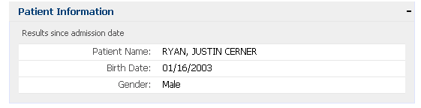
Technical Topics - CSS
HTML without Stylesheet
Stylesheet is applied

Slide 47
Technical Topics - CCL
Query for data
Wraps the data in XML
Passes data to javascript so JS can format data into HTML for output
Discern Explorer Help

Slide 48
Technical Topics - CCL
/* Begin the xml string */
set sXML->data = "<?xml version='1.0' encoding='iso-8859-1' standalone='no' ?><RPT_DATA>"
select into "nl:"
from
person p
plan p
where p.person_id = $personId
head report
sXML->data = concat(sXML->data, "<patientInfo>")
sXML->data = concat(sXML->data, "<patientInfo_label>Patient Name:</patientInfo_label>")
sXML->data = concat(sXML->data, "<patientInfo_result>", p.name_full_formatted, "</patientInfo_result>")
sXML->data = concat(sXML->data, "</patientInfo>")
with nocounter
/* End the xml string */
set sXML->data = concat(sXML->data, "</RPT_DATA>")

Slide 49
Technical Topics – Canned Functions
MPages provides a number of canned javascript functions
Easily add complex features to MPage
For this class we will explore:
APPLINK
CCLLINK
MPAGES_EVENT
XMLCclRequest

Slide 50
Technical Topics - APPLINK
APPLINK is the routine used to open an application or a patient’s chart
Most commonly used to open another Power Chart tab from an MPage
Example

Slide 51
Technical Topics - CCLLINK
CCLLINK is the routine used to build a link to another Discern Explorer (CCL) program within an HTML document.
MPages uses CCLLINK to:
Link to another MPage
Run a CCL program to display output to Discern Report Viewer
Example

Slide 52
Technical Topics – MPAGES_EVENT
The MPages views are interactive, but can we perform actions in the view, i.e. enter results, modify orders, add allergies, etc?
MPAGES_EVENT is the routine used to evoke special conversation events from within a web page
Example

Slide 53
Technical Topics – MPAGES_EVENT
PowerForm – will launch the PowerForm component
Invoke Ad Hoc Charting Window
Invoke an existing PowerForm in either read-only or modify mode
Invoke a new, specified PowerForm

Slide 54
Technical Topics – MPAGES_EVENT
Allergy – will launch the Allergy component
Invoke the Allergy Profile Window
Pull up an existing allergy in modify mode
Invoke the Allergy Add Window with a specified coded or freetext allergy

Slide 55
Technical Topics – MPAGES_EVENT
New Orders – will launch the Modal Order Entry Window (MOEW)
Specify the synonym_id of the order to be placed
Specify an optional order sentence to be used
Specify a nomenclature_id for a diagnosis to be associated with the order.

Slide 56
Technical Topics - XMLCclRequest
XMLCclRequest is a JavaScript class that works similar to the XmlHttpRequest used by AJAX. It allows sections of a web page to be reloaded with CCL program content without having to refresh the entire page.
AJAX – Asynchronous JAvascript with XML
Example

Slide 57
Technical Topics - JQuery
Do we need to write much javascript to make our MPages interactive?
jQuery is a lightweight JavaScript library that emphasizes interaction between JavaScript and HTML
Jquery.js – Freely available
“Black Box”
Write small amount of code to utilize jquery.js
Examples

Slide 58
MPage Web Service
MPages 2.0 introduced the new MPage Web Service.
Provides a mechanism for interfacing with Discern MPages. The service provides a URL-based API that allows any user with a browser and Millennium credentials to access their MPages.

Slide 59
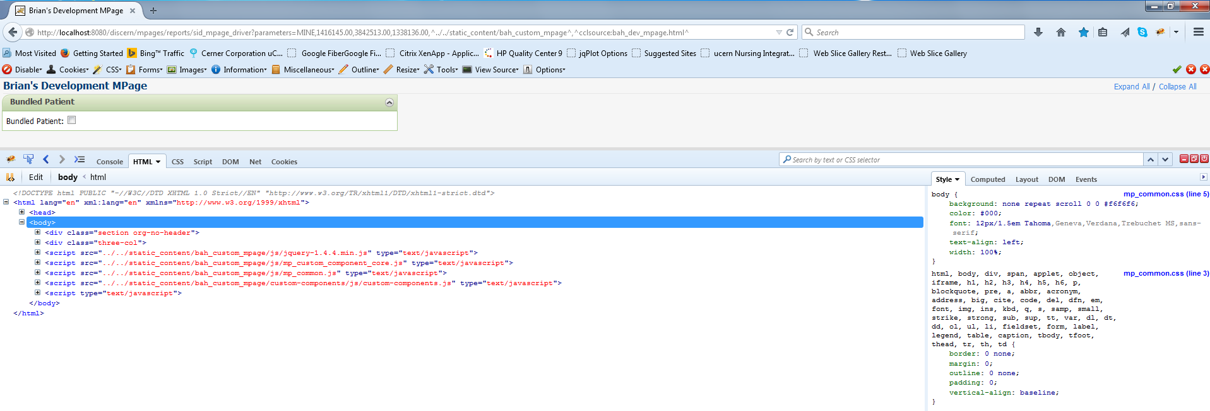
MPage Webservice API
Allows end-users to view an MPage from any device without Citrix requirements (ie mobile, desktop, etc)
MPages mobile and MPages Reach utilize this.
Uses SSL as well as Millennium credentials to authenticate
Allows for better debug options for MPage developers
Firefox uses Firebug plugin
Chrome has its own Developer Tools built-in.

Slide 60
MPage Webservice Set-up
Can be set-up on local machines through downloading Apache Tomcat
Service pack
Has to be set-up in order to use MPages V5 or greater
Contact your webservice personnel to find the URL host (ie. http://localhost:8080 for local installs)
Notes:
Standard Mpage Views and Viewpoints are not supported to be ran solely on the webservice, but custom MPages can be if configured correctly.

Slide 61
MPage Webservice URL
Has 5 pieces
Protocol
Host
Port (usually hidden)
File/CCL object
Query string/CCL Params
Notes:
Reference up to the CCL Object in the file string can vary slightly but always ends in “/mpages/reports/”
Your static content should be hosted on the same webservice as most services don’t provide talking between javascript cross-domain.
Static content is usually stored in the “discern” folder that is created when the discern.ear file is deployed to the webservice.

Slide 62
Technical Topics – MPage Flow
MPage driver program is executed
MPage appears on screen
Driver program reads in html file and opens the html file
Style is applied from stylesheet (CSS)
The contents of the .css and .js files are inserted into the <head> section of the html
Javascript inserts formatted data into placeholder <div>’s
‘onload’ event in <body> tag of html kicks off the javascript
Javascript makes AJAX calls to CCL programs to retrieve data
Javascript loads received data into XML/JSON object

Slide 63


MPages Future – GAIA and FUSION

Slide 64
GAIA
MPages GAIA is a highly extensible development ecosystem streamlining the MPages development process.

Slide 65
GAIA
30 minutes or less to setup an MPages development environment.
Quick feedback cycle.
One-stop-shop for development tools.
Always current development ecosystem.
Developer focus on content and functionality.
Plugins like Live Dev and millennium proxy are available.
Millennium proxy allows Gaia to connect to a Millennium domain through a URL.
Can execute arbitrary CCL programs.

Slide 66
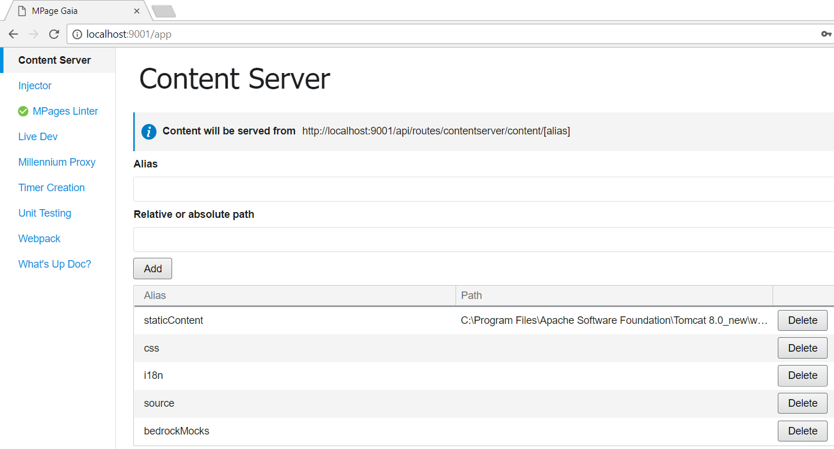
GAIA
Access GAIA via browser http://localhost:9001/app

Slide 67
MPages Fusion

Slide 68
MPages Fusion
What is it?
MPages Fusion is a Code Companion Library of reusable UI elements that are inherently responsive and aligned with One Cerner Style.
Who should use Fusion?
All Cerner and Client Engineers should use Fusion for MPages Development
Guiding Principles
Consistent
Responsive
Fast
Integrates easily

Slide 69
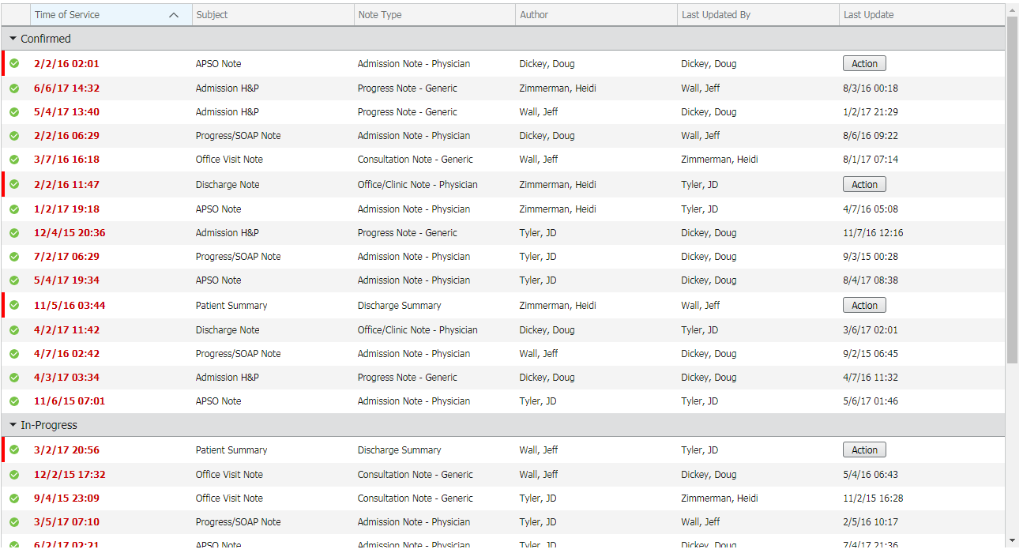
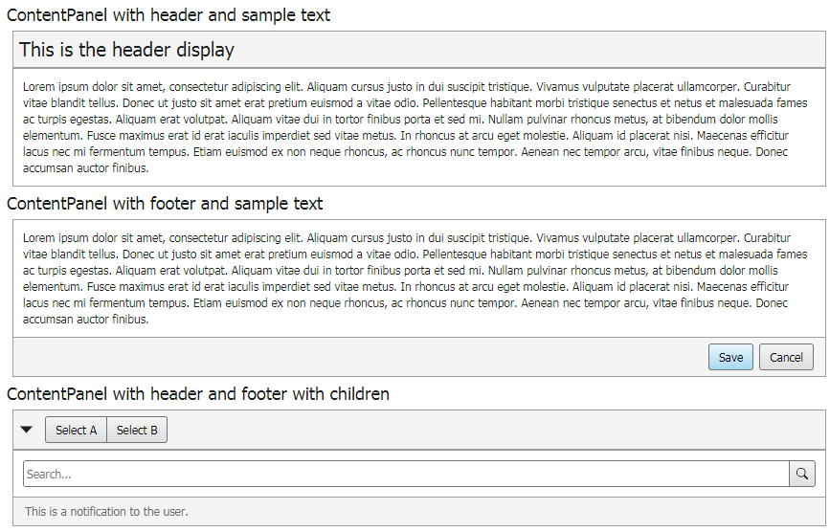
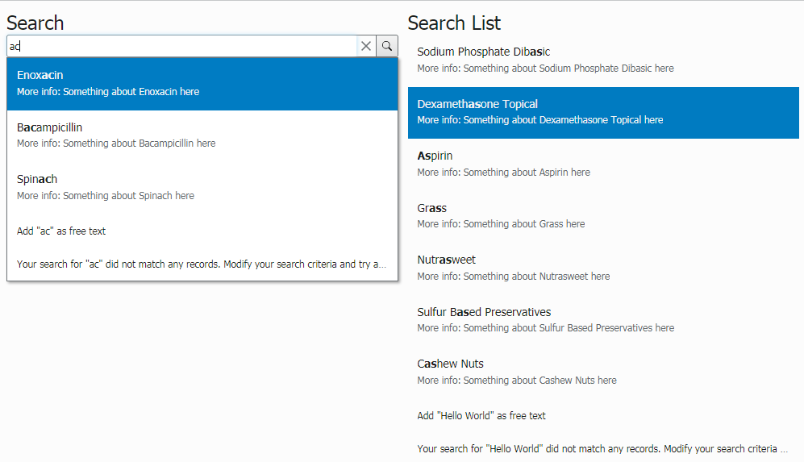
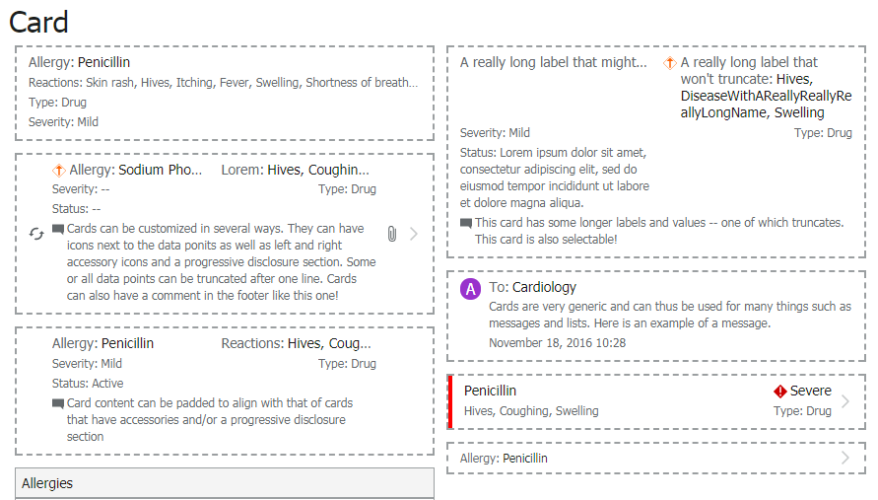
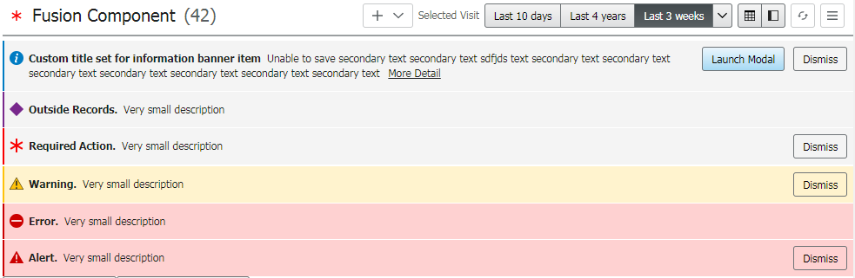
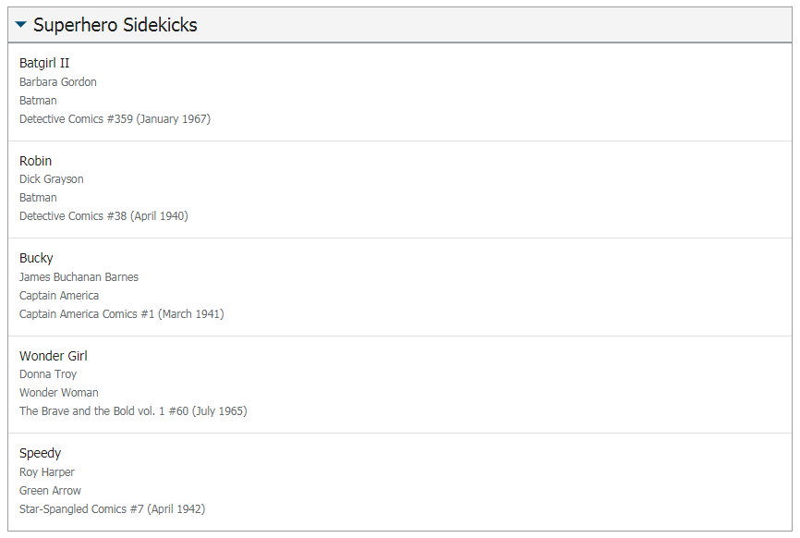
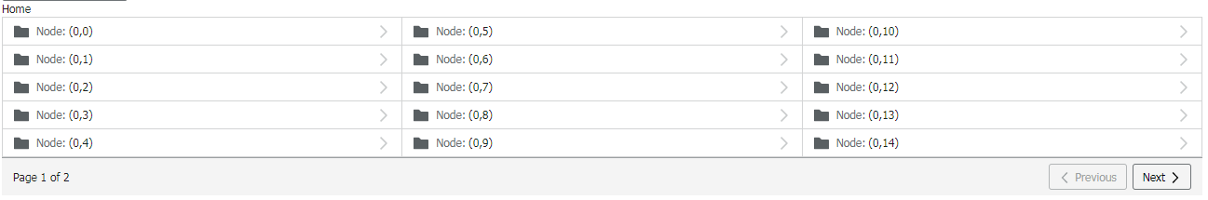
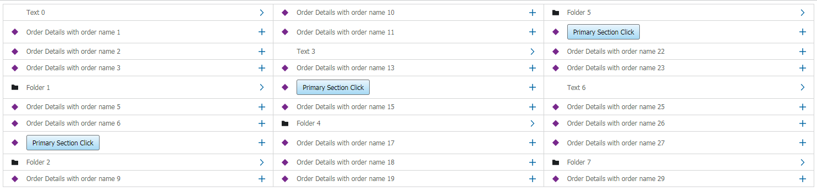
MPages Fusion
Reusable UI controls that can be updated centrally to ensure a consistent user experience.

Slide 70
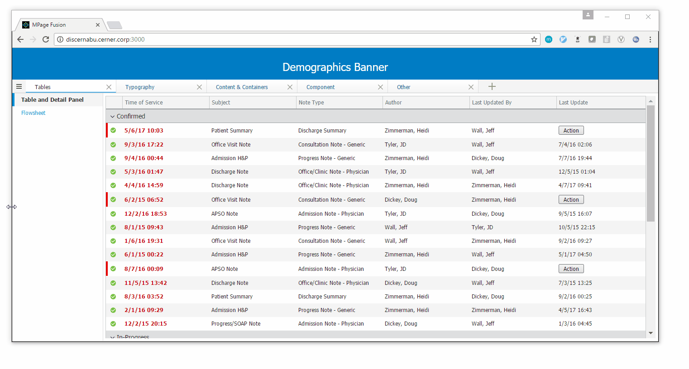
MPages Fusion
All controls are responsive and adapt to the device and screen size being used.

Slide 71
Mpages Development “Tools”
We will use Discern Visual Developer for class
HTML file and .PRG’s will reside on the backend
Javascript (JS) and Stylesheet (CSS) will reside on frontend
JS and CSS will be referenced by HTML during run time.
MPage will be developed by creating/modifying HTML, JS, CSS, and .PRG’s in DVDev

Slide 72
Training Agenda
Day One
Begin Exercises 1-7
Design ‘Working Session’ Project (~4:30-5:00pm)
Day Two
Complete Exercises 8-14
Start Custom Component Overview and Exercises
Day Three
Finish Custom Component Exercises
Demonstrate how to put a custom component in a standard Mpage (Bedrock).
Start ‘Working Session’ Project
Day Four
Finish ‘Working Session’ Project

Slide 73
Questions?

